Slide 1


Media Plus
Solution for Advertisement Agency made on Tally.ERP 9 Platform

Slide 2
Publication & Broadcasting

Slide 3
Functionality of a Media Agency
Media Agency
Publication
Broadcasting
Hoarding
Other Services

Slide 4
Process in Publication
Publication
Release Order
Ro Vouching
Client Invoice
Publication Invoice
VTS/Adv Tearing

Slide 5
Process in Broadcasting
Broadcasting
Release Order
Mark as Aired
Client Invoice
Broadcaster Invoice
Clip Taking

Slide 6
Features – Publication & Broadcasting Module
RO- Release order
Insertion helper for Quick Release order Generation
Option to Mark Insertion as Published, Not Published , Missed
Accounts & Finance
Client Invoice for Multiple Release Order
Publication invoice for Selected Insertion of Release Order
Release Order Register with Filter of , RO Number , Insertion Date, Publication Agency, Party Name.
Publication Invoice Pending
Client Invoice Pending
Insertion wise Voucher Tearing Sheet VTS and Report of Pending , Received.
Ro Wise Profitability Report
Ro Wise Outstanding Report
Publication Purchase Register
Sales Register
360* Analysis Report
Newspaper/Channel wise, Client Wise, Edition wise, Category wise, Edition wise.
Top Clients, Top Agent/Executive

Slide 7
Publication Reports Available
Publication Ro Register (Classified/Regular)
Publication Invoice Pending
Publication Invoice Register
Client Invoice Pending
Sales Register
Multi Bill Report
Top Client & Top Agent Report
Sales Analysis- Newspaper, Edition, Position, Client, Category
Voucher Tearing Sheet Register
(VTS Register)
Agent/Executive Commission Report
Profitability Report
(Ro Wise , Insertion Wise)
Outstanding Report
(Client & Publication
RO Vs Invoice Variance
(Client & Publication Invoice
*Support GST Reporting
(GSTR-1, GSTR-II, GSTR-3B)
Export & Email Compatibility
( For all mention Reports)

Slide 8
Broadcasting Reports Available
Broadcasting Ro Register
Broadcasting Invoice Pending
Broadcasting Invoice Register
Client Invoice Pending
Sales Register
Multi Bill Report
Top Client & Top Agent Report
Sales Analysis- Channel, Edition, Client, Category
Clip Register
(VTS Register)
Agent/Executive Commission Report
Profitability Report
(Ro Wise , Insertion Wise)
Outstanding Report
(Client & Broadcaster
RO Vs Invoice Variance
(Client & Broadcasting Invoice
*Support GST Reporting
(GSTR-1, GSTR-II, GSTR-3B)
Export & Email Compatibility
( For all mention Reports)

Slide 9
Excel/CSV Integration
Excel Import
Masters
Ledger
Transaction
Release Order
Client Invoice
Press Invoice

Slide 10
Hoarding Management

Slide 11
Process in Service Management
Hoarding
Quotation
Booking
(Purchase Order)
Client Invoice
Purchase Invoice

Slide 12
Features in Spare Management
Hoarding Quotation
(To Client)
Hoarding Booking
Purchase Order (Rented)
(To Hoarding Owner)
Client Invoice
Purchase Invoice
Receipt/Payment

Slide 13
Supportive Feature of Service & Spares
Warranty
Spare issue on Warranty
Warranty Spares report
Customer Management
Warranty Claim using Auto Journal
Post Service Follow Up – Complaint/Satisfied
Timing Sheet
Free Service Coupon Claim
Warranty Labor Report
Service Battery Report
Vehicle History
Service Reminder – Outside Customer
Service Follow Up – SMS , Calls

Slide 14
Hoarding Reports Available
Hoarding List Report
(Filter of Own/Outside & Vacant , Occupied)
Hoarding Expiry Register
Hoarding Occupancy Dashboard
Hoarding PO Register
Other PO Register
Hoarding Purchase Register
Quotation Register
Booking Register
Billing Register

Slide 15
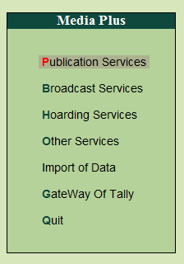
Screen View

Slide 16
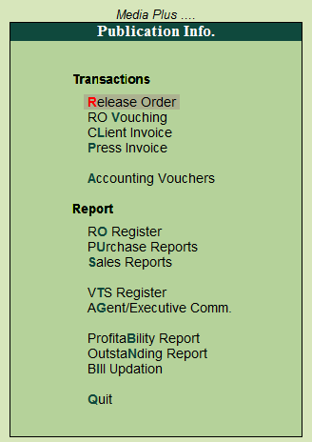
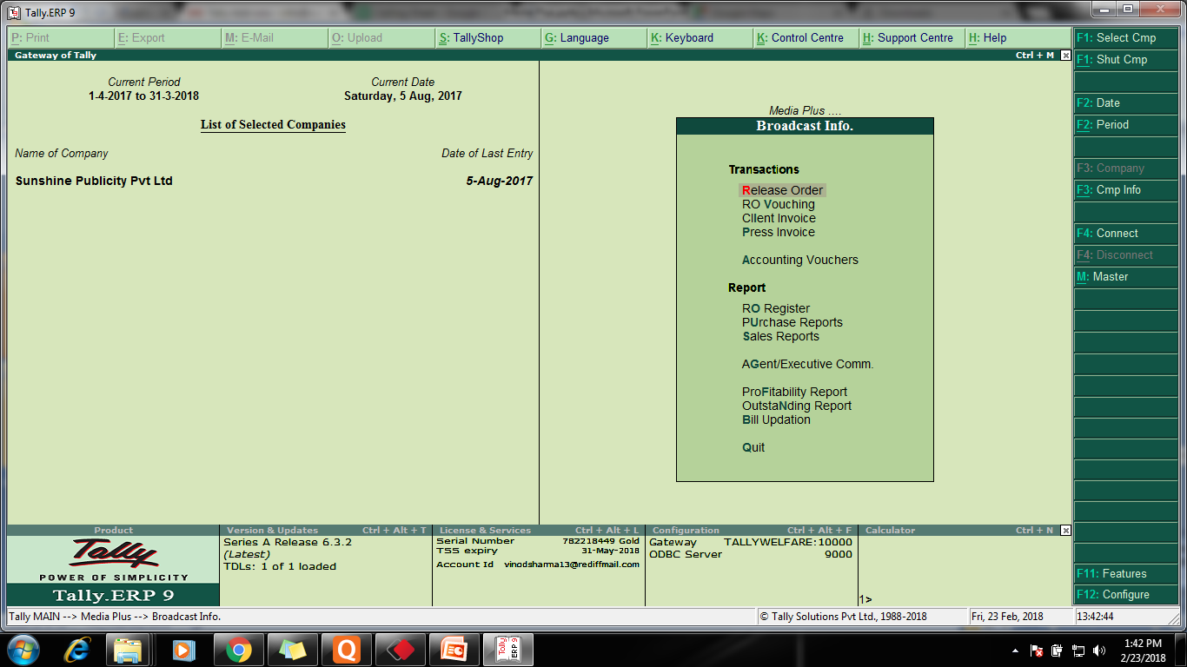
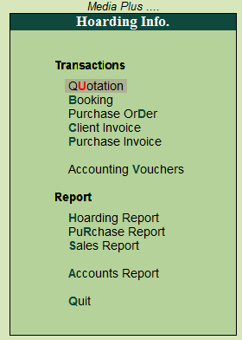
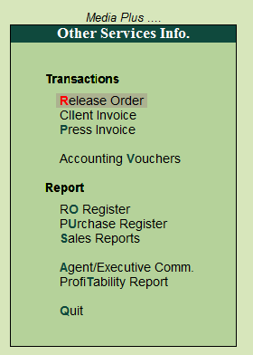
Gateway

Slide 17
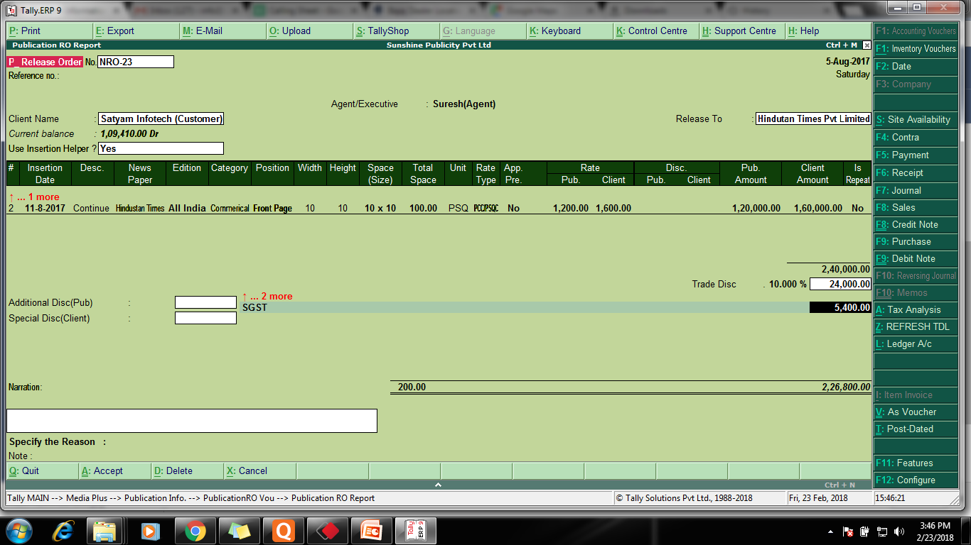
Release Order Publication

Slide 18
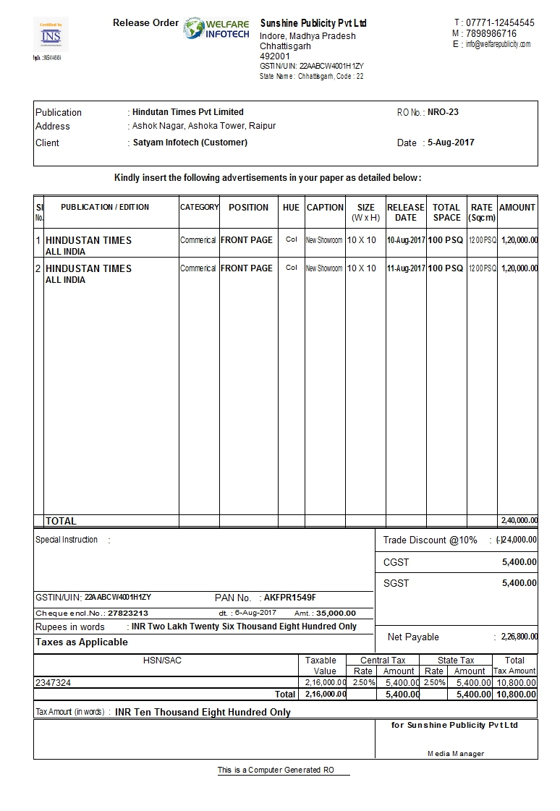
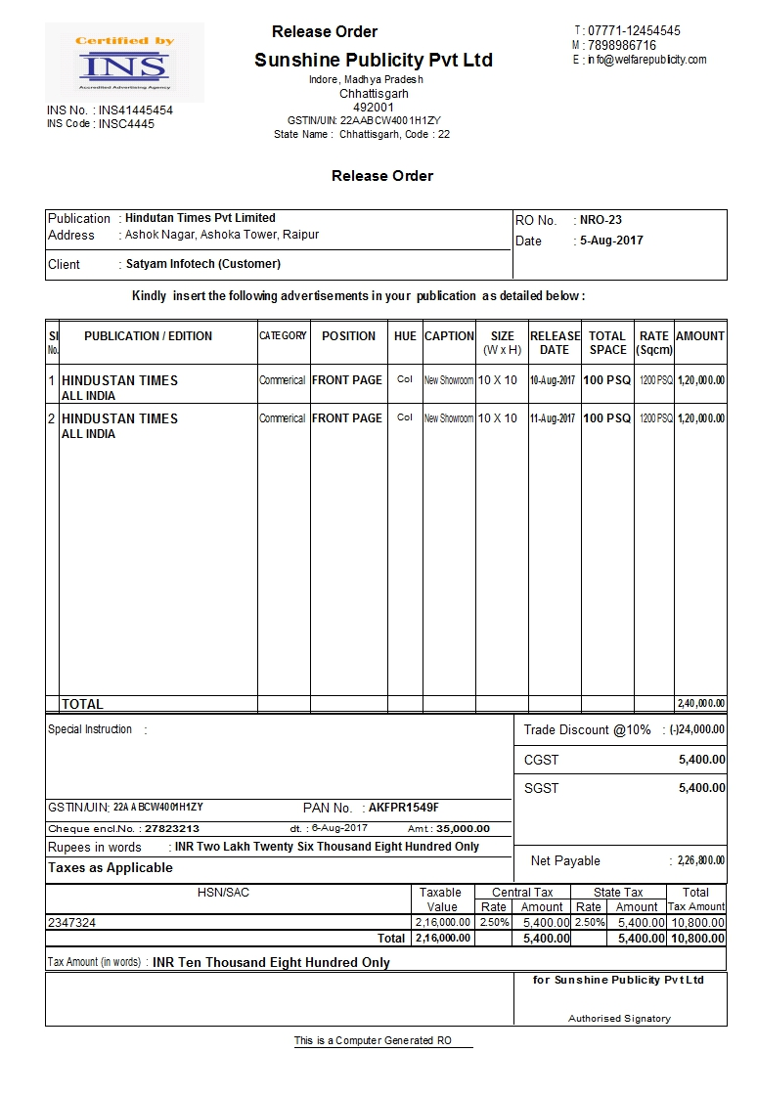
Release Order Publication

Slide 19
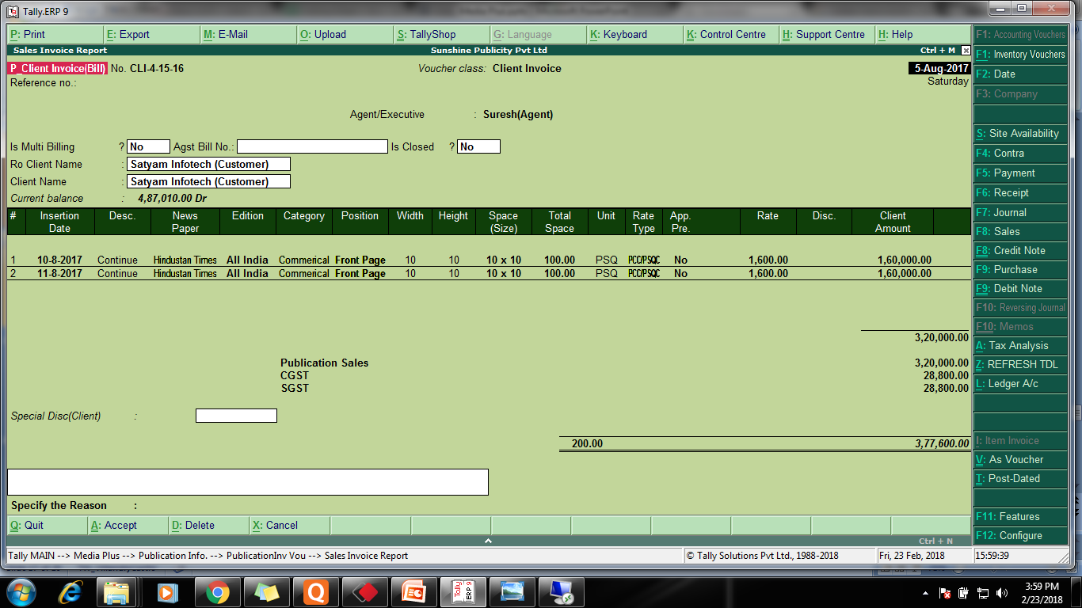
Client Invoice Publication

Slide 20
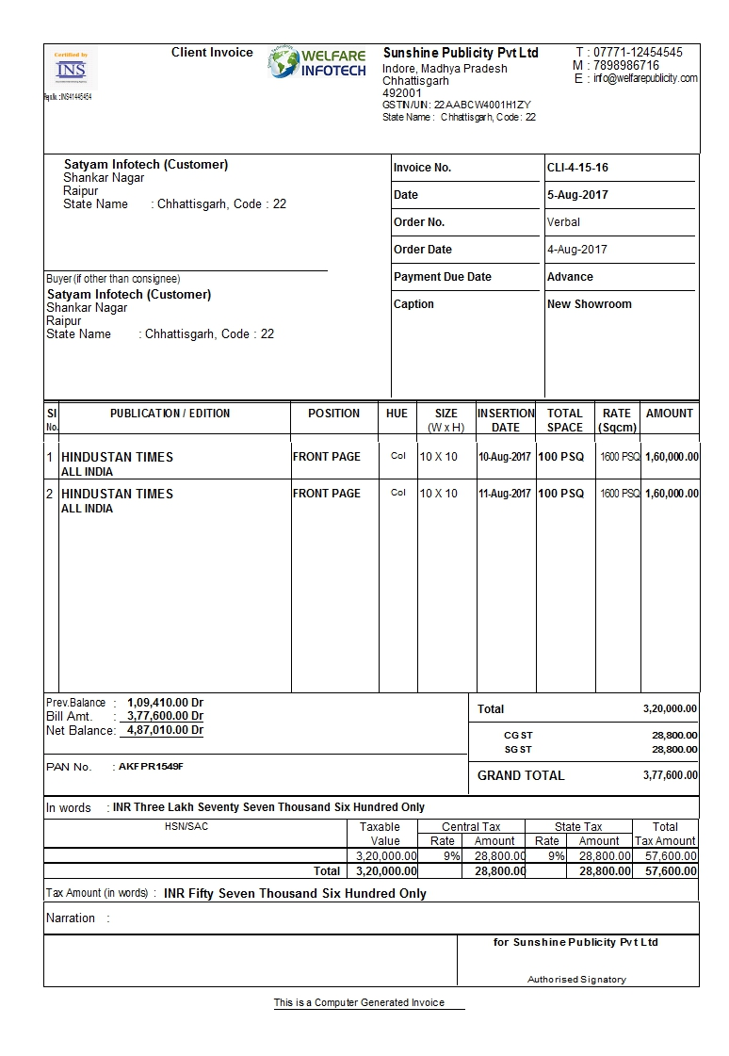
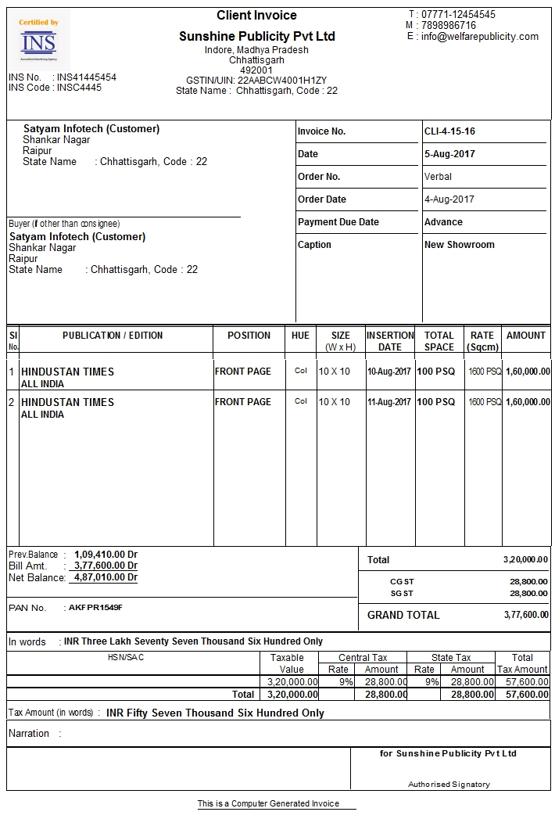
Client Invoice Publication

Slide 21
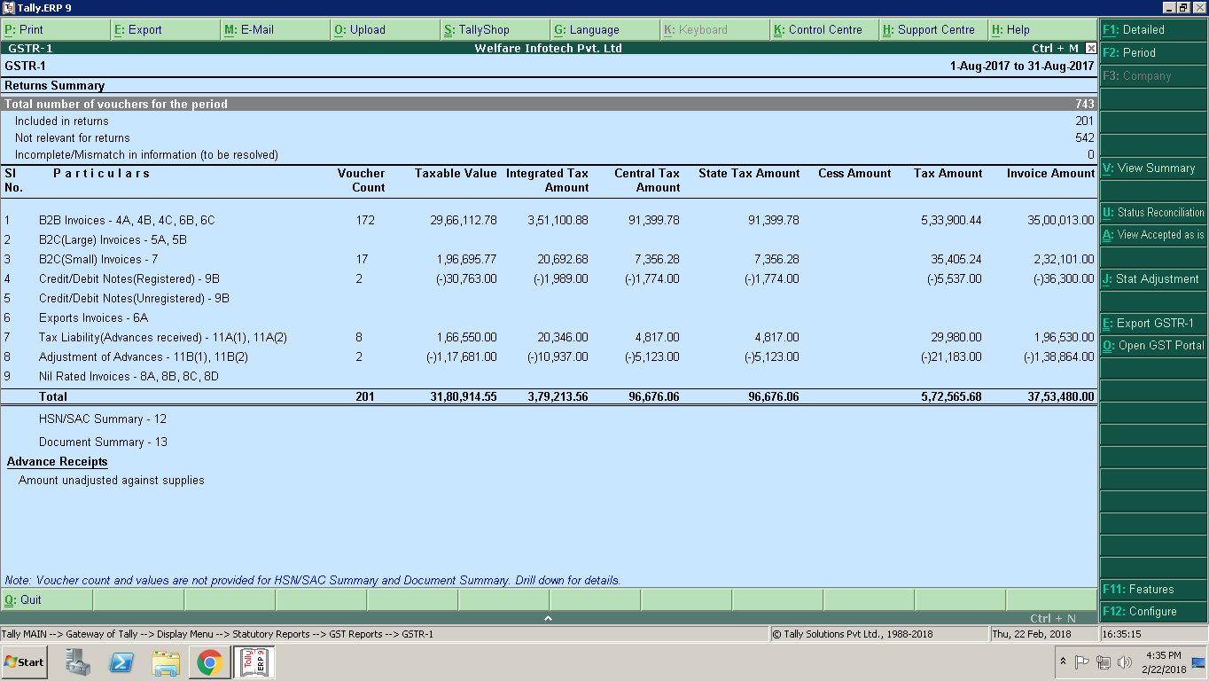
GSTR-1

Slide 22
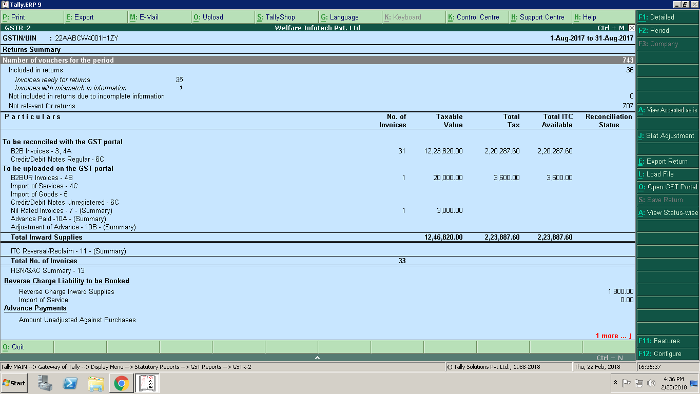
GSTR-2

Slide 23
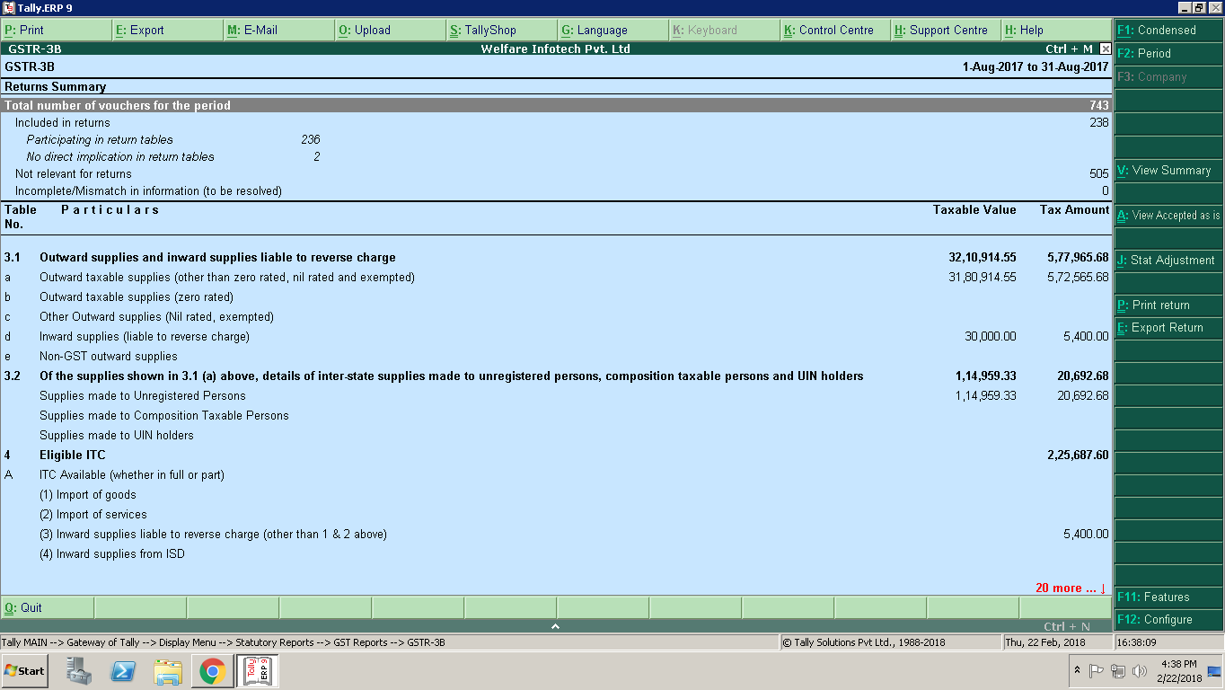
GSTR-3B

Slide 24


Thank You
Call us - +91-9755514444
Mail us - ravi@welfareinfotech.com
Website - www.welfareinfotech.com
Skype - ravi.mishra89

