Slide 1
Iron & Steel Manufacturing Module
www.welfareinfo.net | rahul@welfareinfo.net | +91-7898986653

Slide 2
Standard Features
Gate In
Gate Out
Voucher Approval
Sales & Purchase Order Module
Broker wise sales & purchase Order
Cross party Billing adjustment with Order
Rate Difference during sales entry
Test certificate (entry & print)
Printing "Souda Patrak“
Pre-printed Invoice
Indent Module
Freight calculation
Auto Email
SMS Module
Payroll Management
Data Security
Data Synchronisation
GSTR-1, GSTR-2, GSTR-3B

Slide 3
Advance Features
Digital Signature
E Way bill printing from Tally
OTP for Voucher Alteration
Owner Daybook
Document Attachment with Browse
Protect GST Filed Figures

Slide 4
REPORTING
Gate Register Voucher Approval Reporting
Sales & purchase order register Payroll Reporting
Broker wise commission report Indent Reporting
Broker wise out standing Out Standing due bill wise Reporting
Broker wise sales report Block Ledger Reporting
Test certificate report Lock GST Return Vouchers
Owner Days Books System Date Time On Startup
Document management Excel Theme in Reports
Voucher type security Account Settlement

Slide 5
Indent Module
Indent voucher Department wise Indent
Enquiry Creation Enquiry Register Indent
Purchase Order Purchase order outstanding indent
Rcpt Note GRN Register
Rejection Rejection Register
Purchase Purchase Register
Issue Entry Issue Register

Slide 6
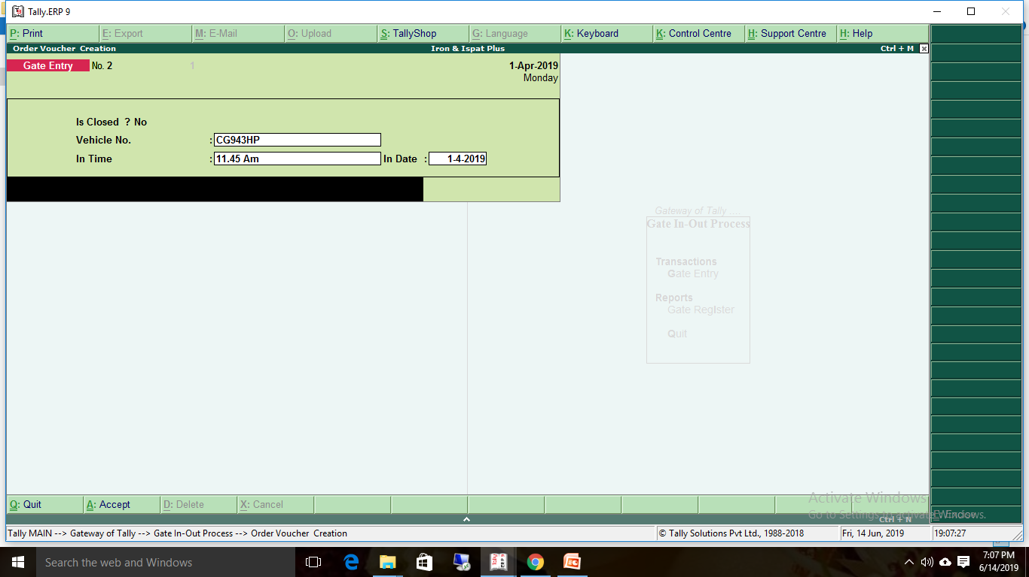
Gate In entry

Slide 7
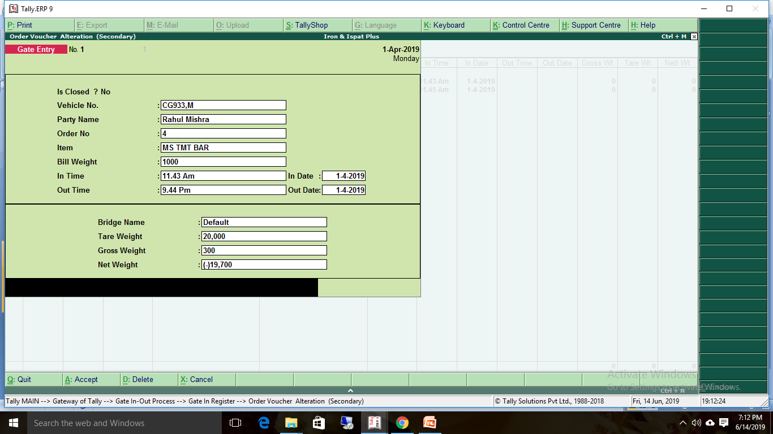
Gate out Entry

Slide 8
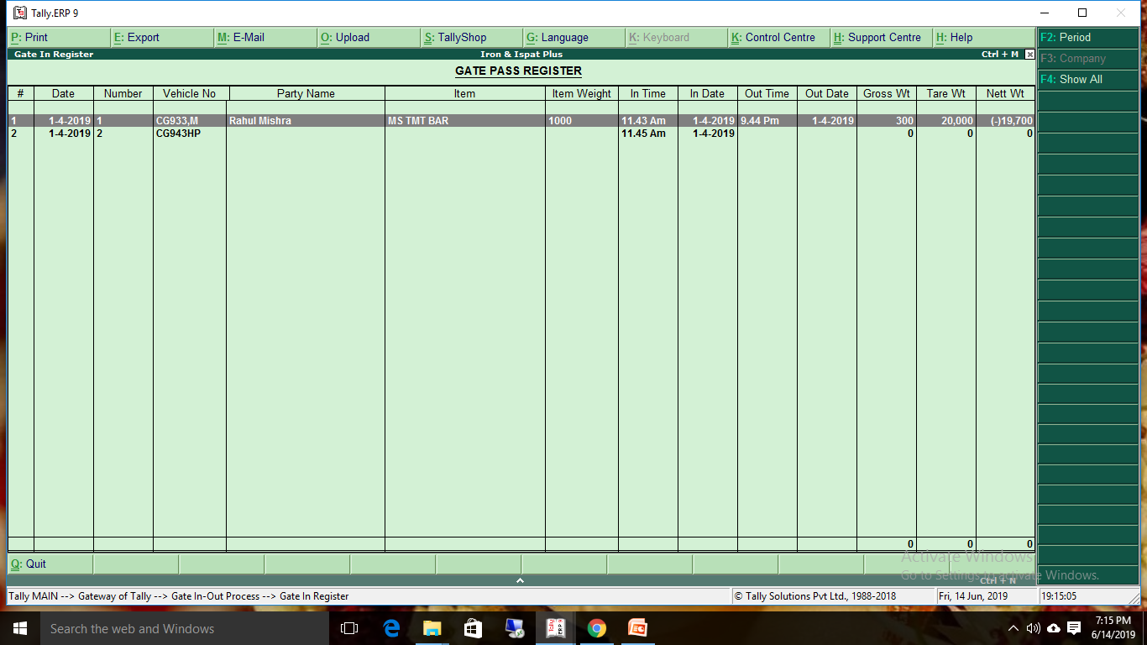
Gate in & out Register

Slide 9
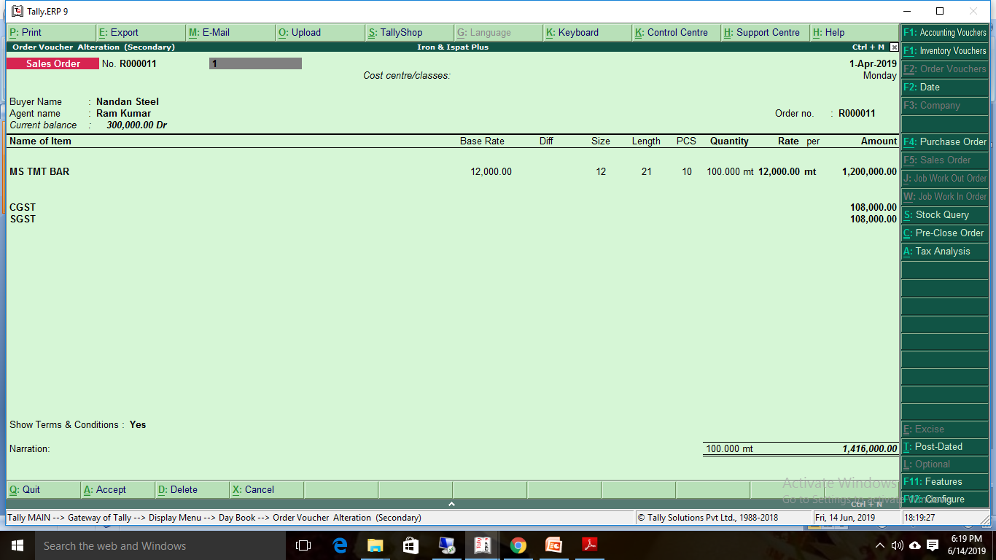
Sales Order

Slide 10
Printing "Souda Patra

Slide 11
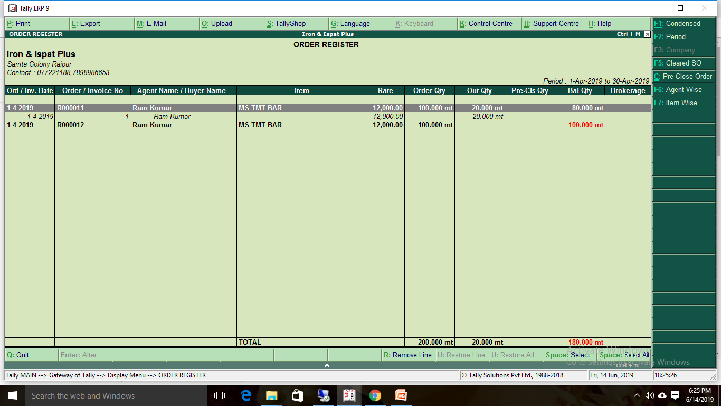
Sales order register

Slide 12
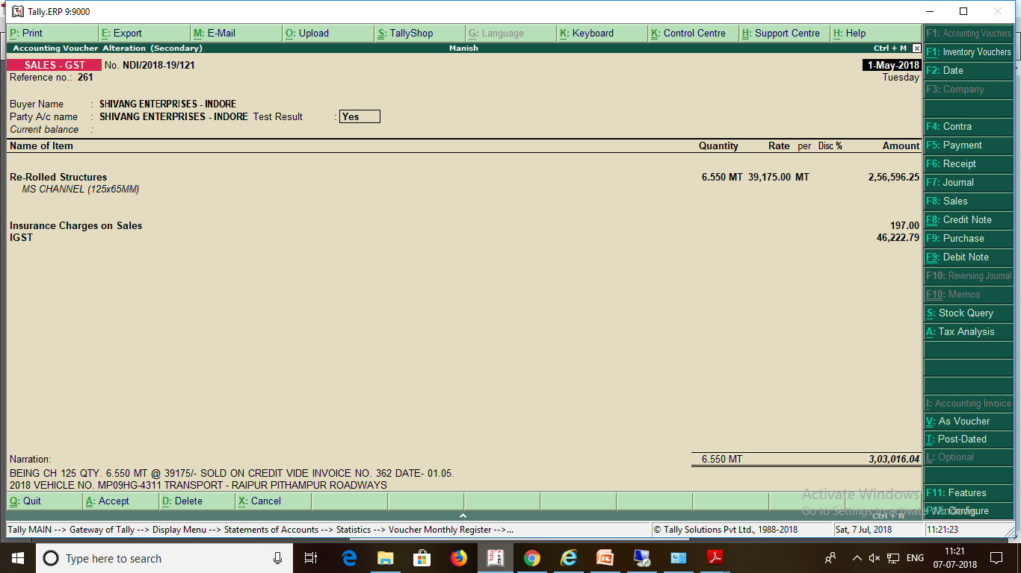
Sales Invoice

Slide 13
Sales print format

Slide 14
Tc print

Slide 15
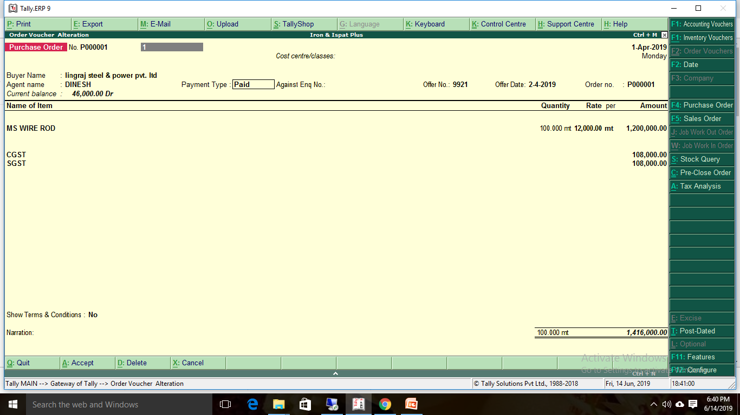
Purchase Order

Slide 16
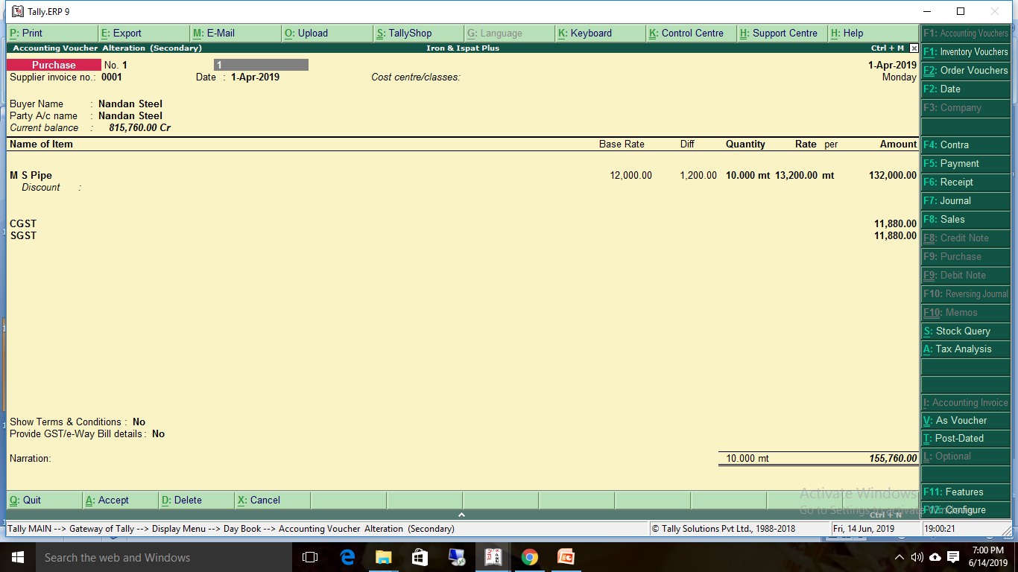
Purchase Entry

Slide 17
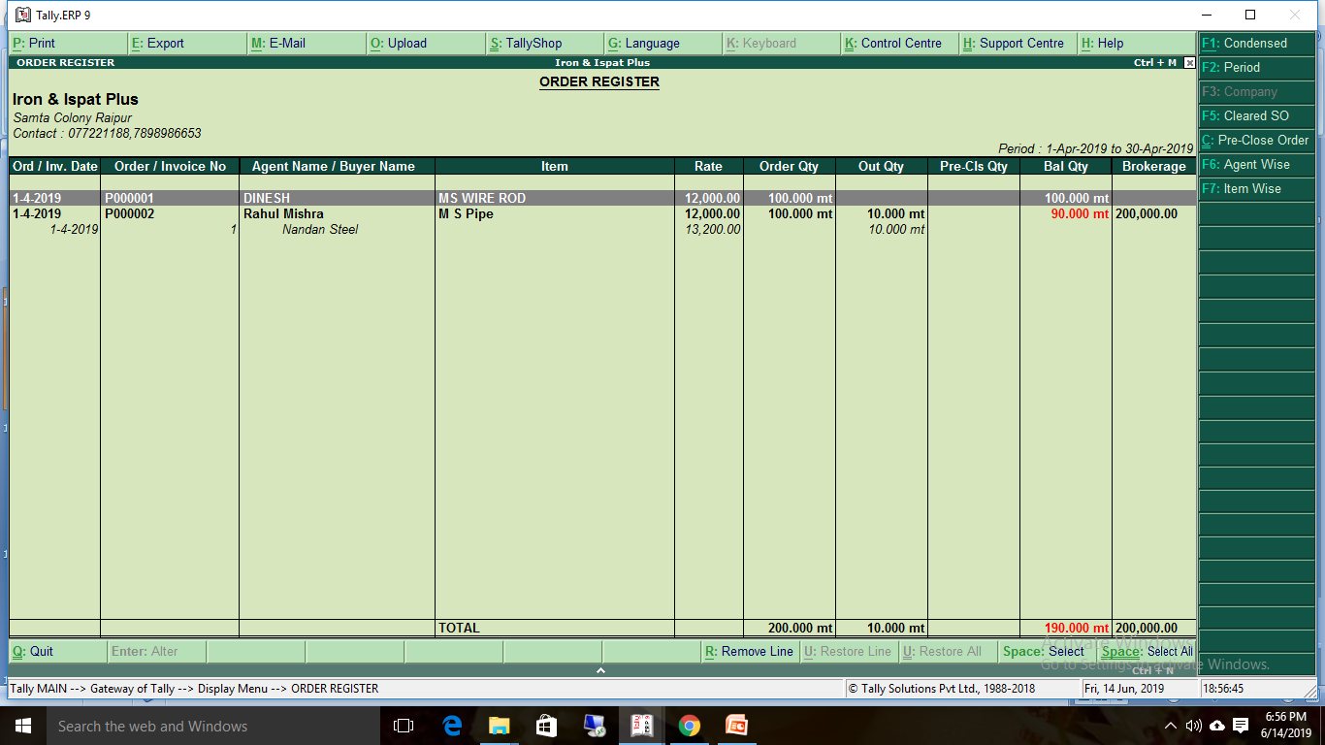
Purchase order register

Slide 18
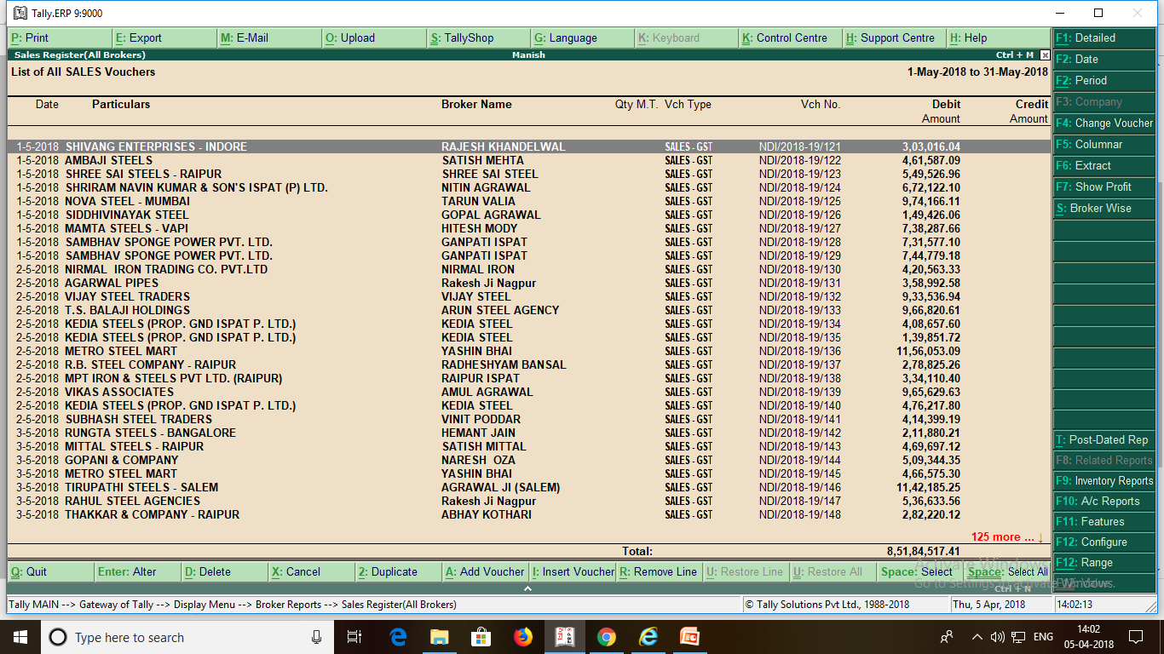
Broker wise sales

Slide 19
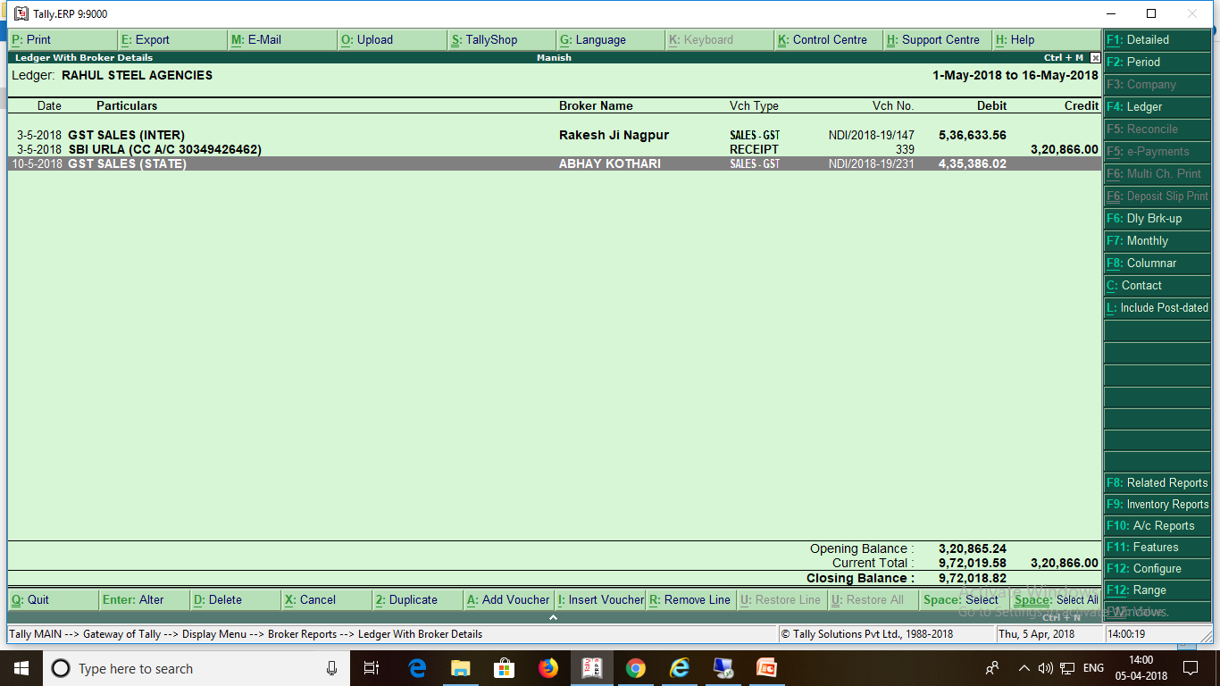
Ledgar wise Broker Sales Details

Slide 20
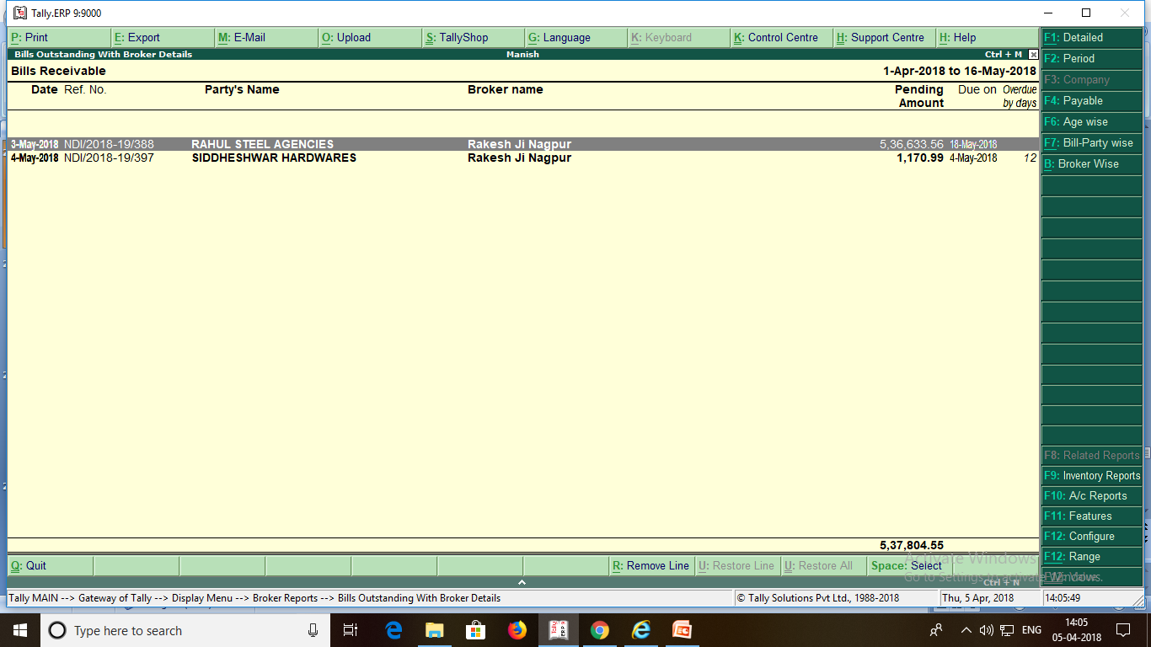
Broker Bills Ousttending

Slide 21
Auto Email

Slide 24
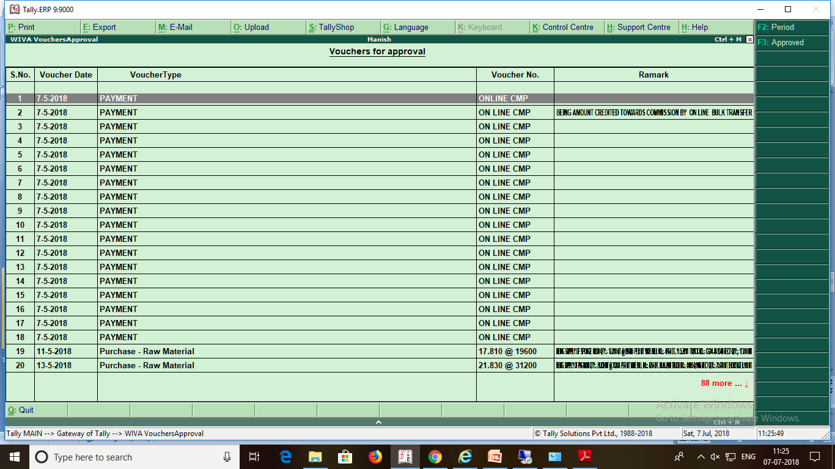
Voucher type security

Slide 25
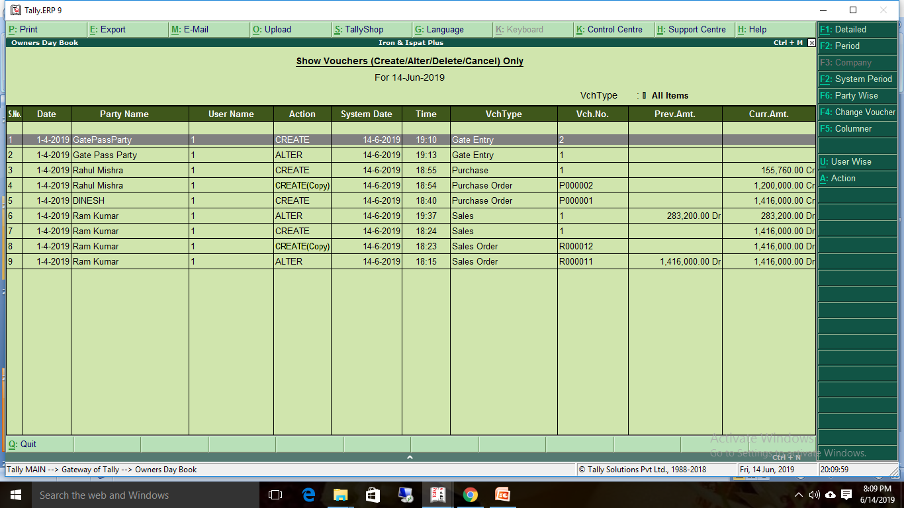
Owner Days Books

Slide 26
Document management

Slide 27
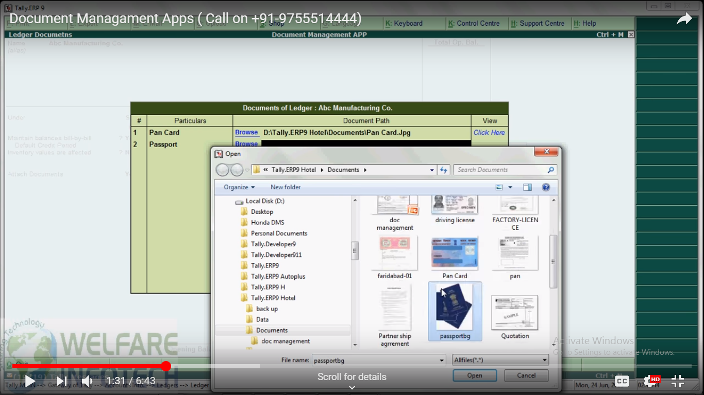
Document management ledgers Attach

Slide 28
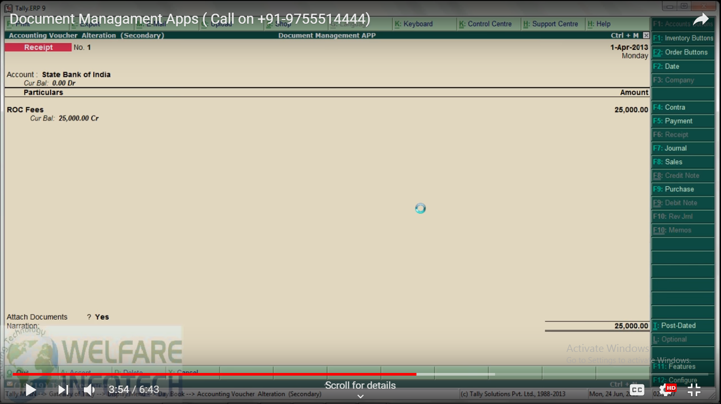
Document management voucher Attach

Slide 29
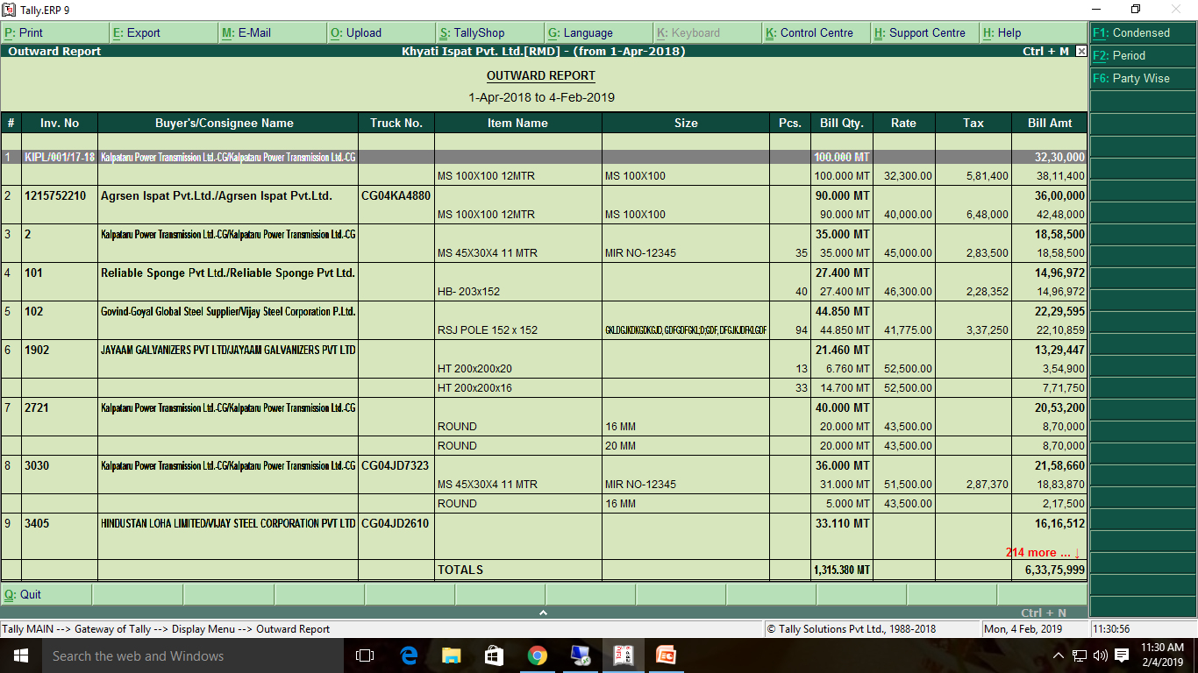

Slide 30
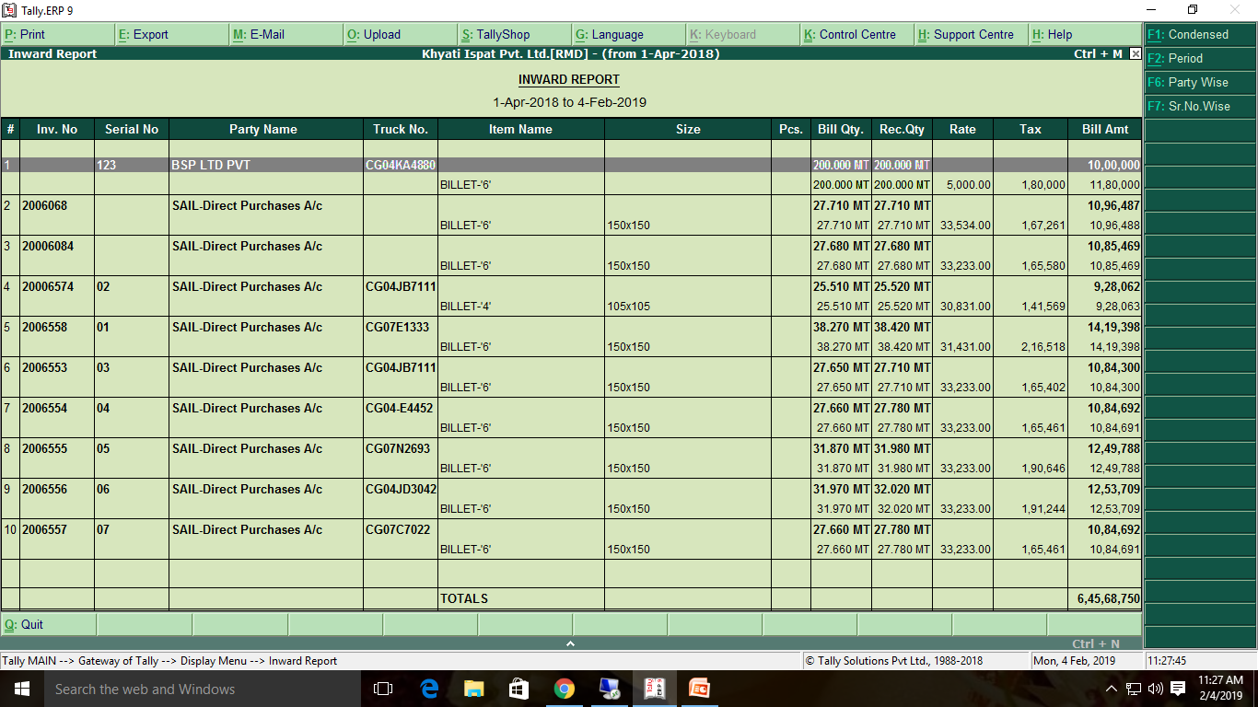

Slide 31
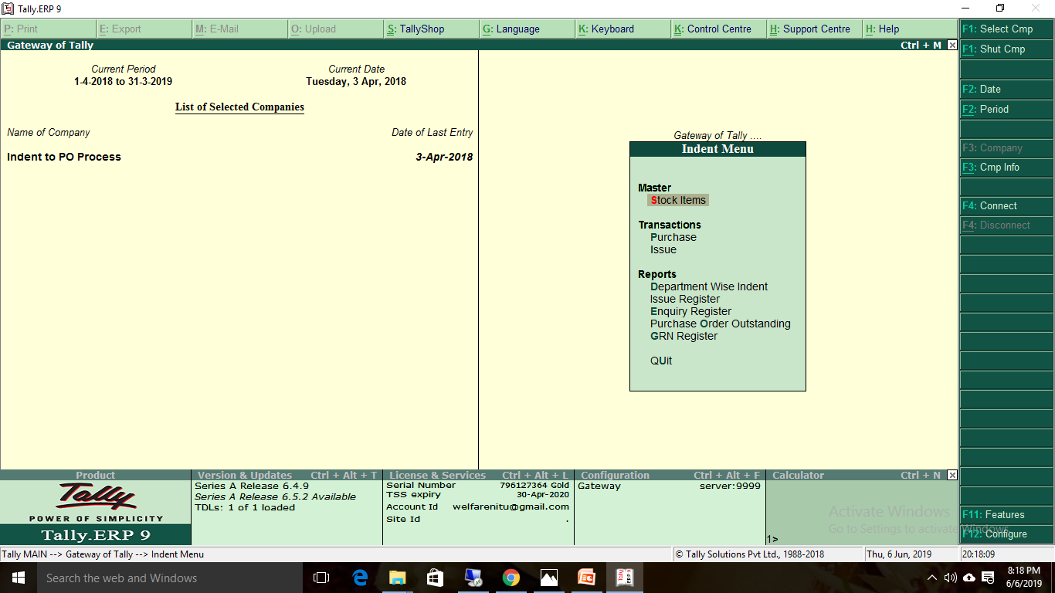
Indent Menu

Slide 32
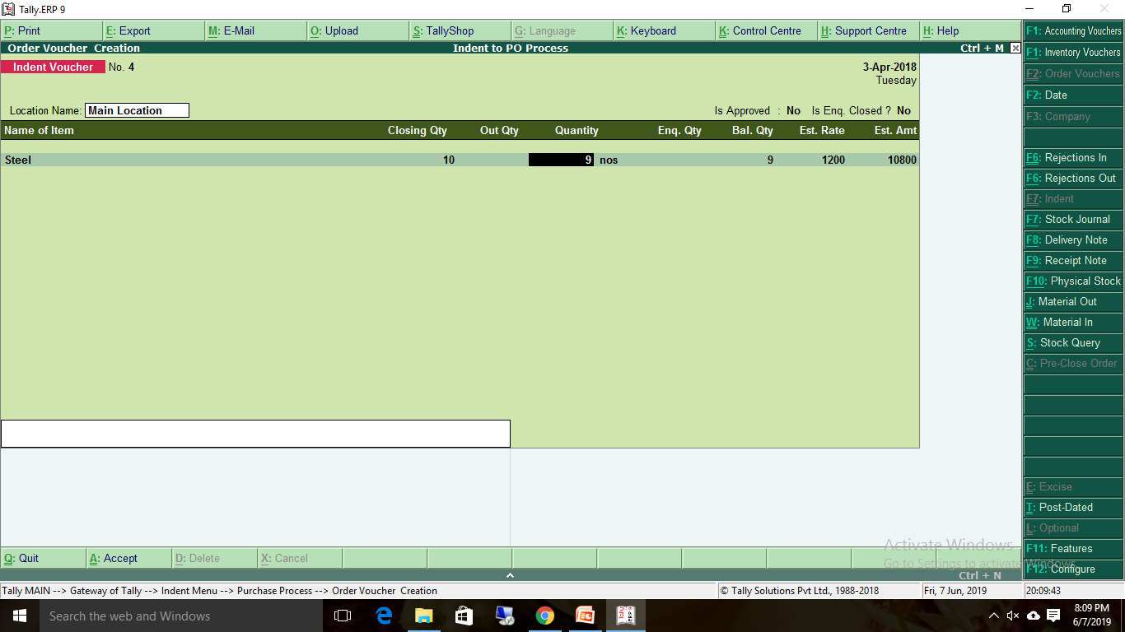
Indent Voucher Entry

Slide 33
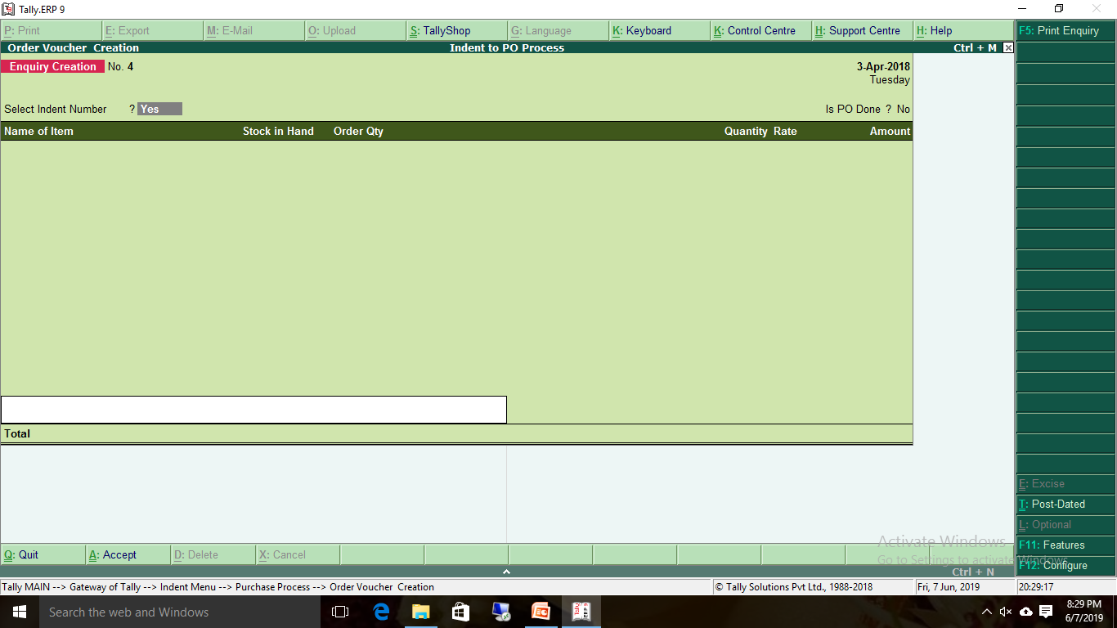
Enquiry creation

Slide 34
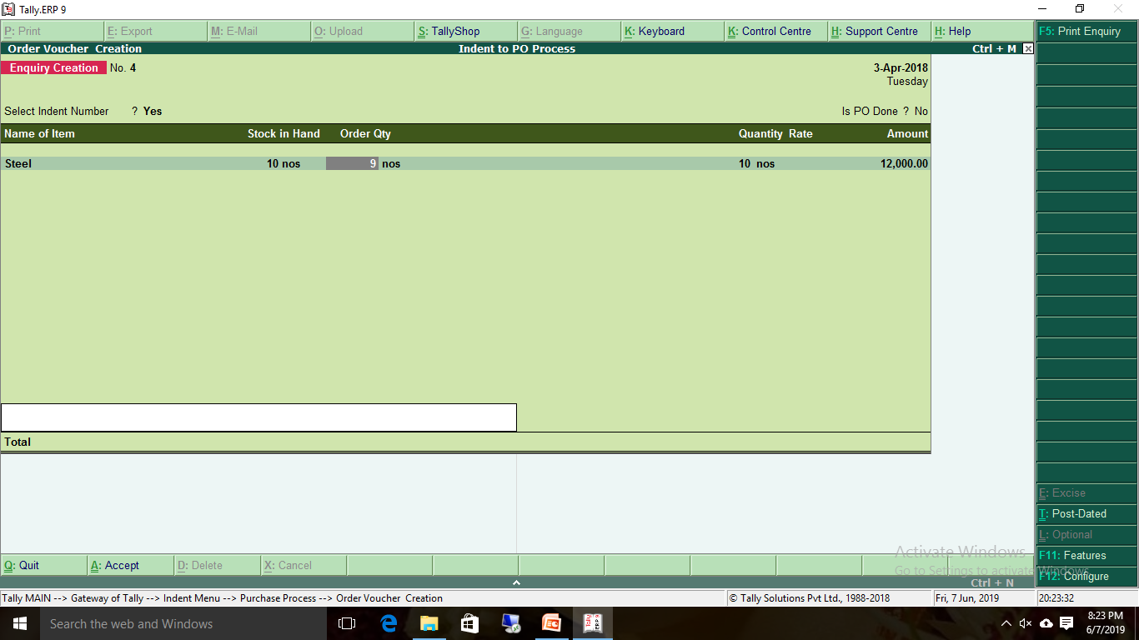
Enquiry creation

Slide 35
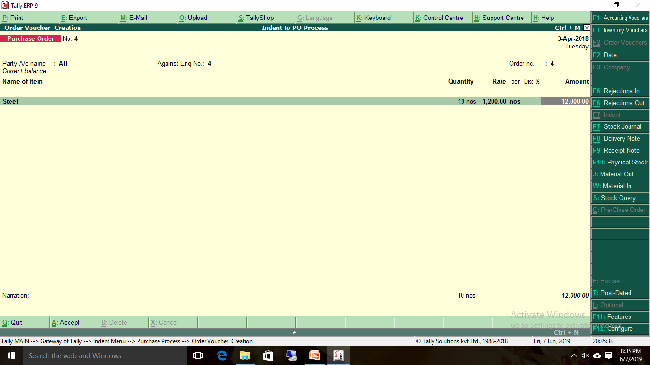
Purchase Order

Slide 36
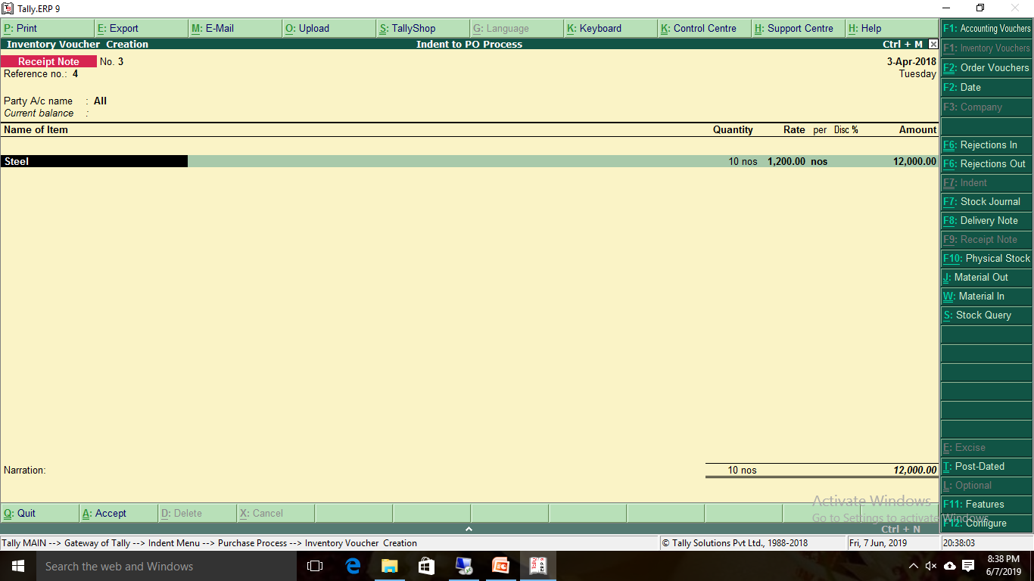
Receipt Note

Slide 37
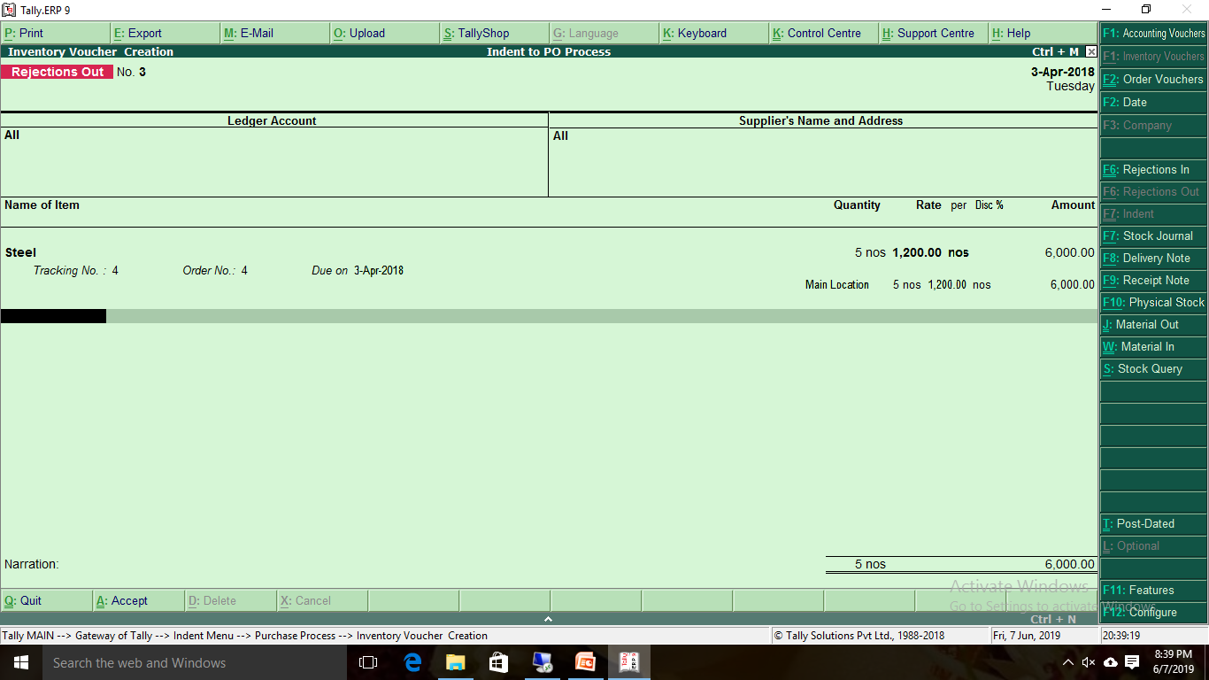
Rejections out

Slide 38
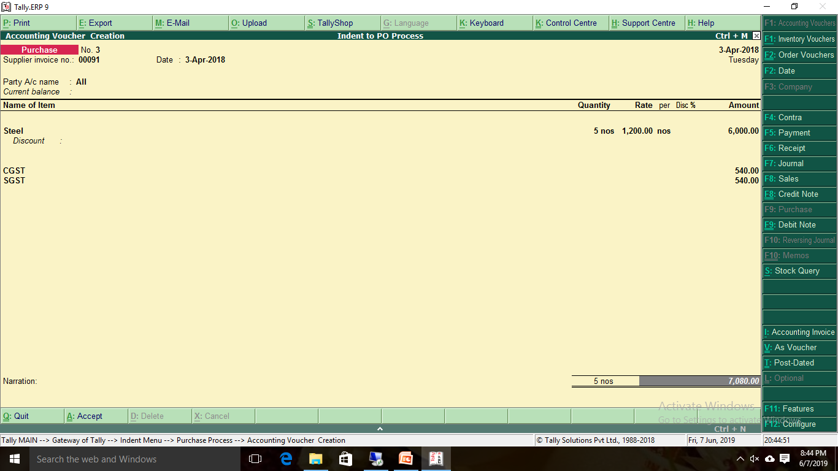
Purchase Entry

Slide 39
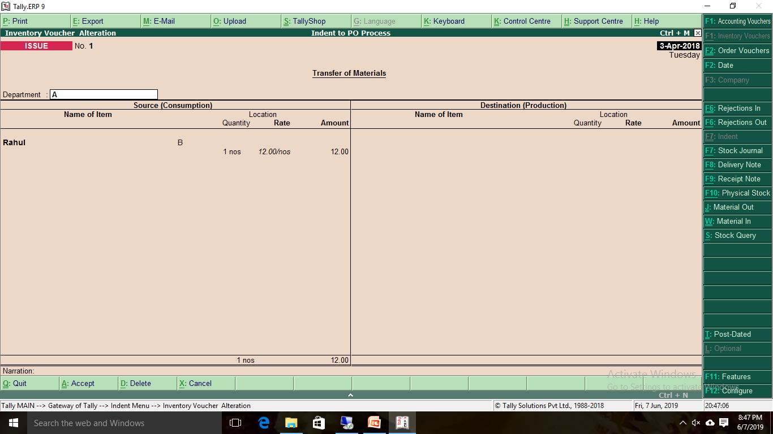
ISSUE

Slide 40
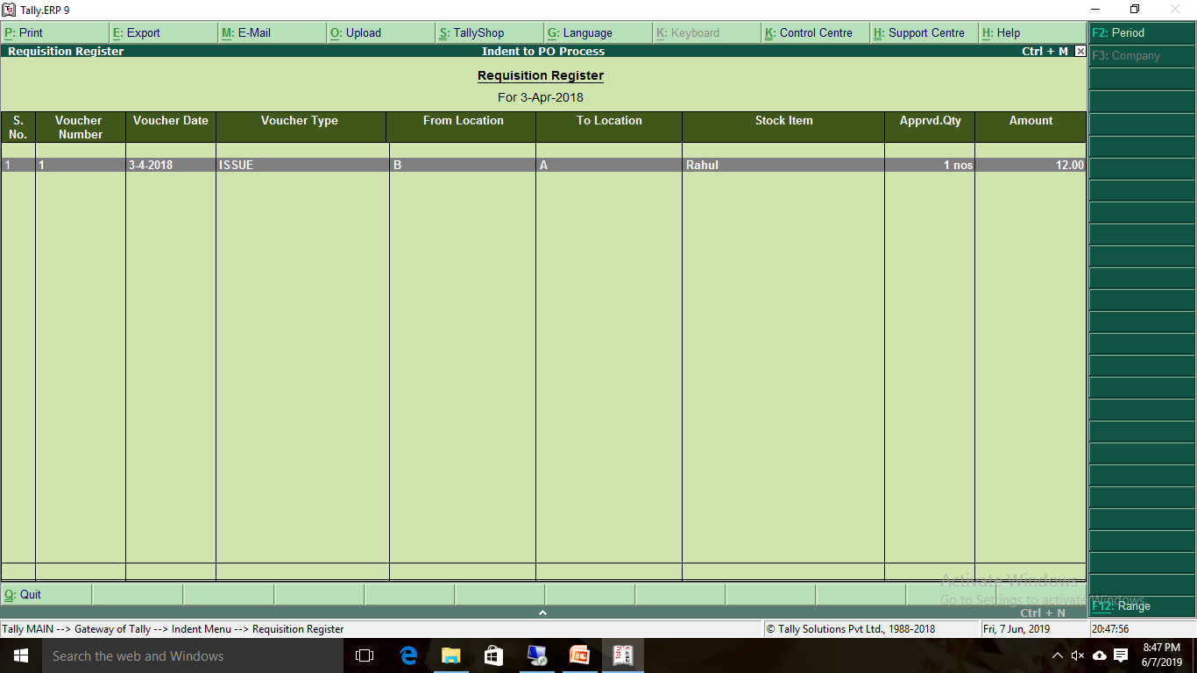
ISSUE REGISTER

Slide 46
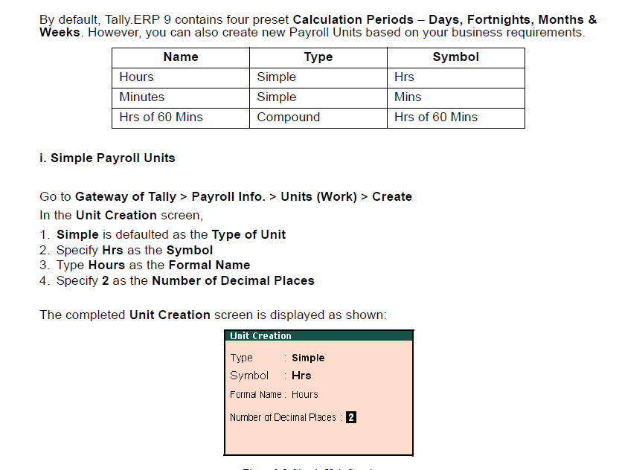

Slide 47
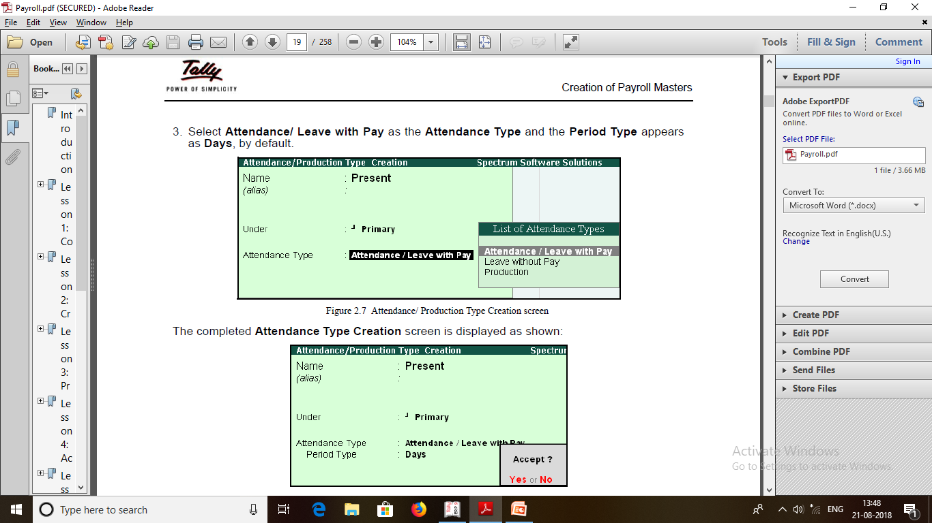

Slide 48
Thank You
www.welfareinfo.net | rahul@welfareinfo.net | +91-7898986653

